Slide 1
An analysis on Used Cars in the United Kingdom
DSCI 5260 PROJECT
Chintan Rajesh | Jonathan Moncrief | Aziz Haryani | Sreshta Budeti

Slide 2
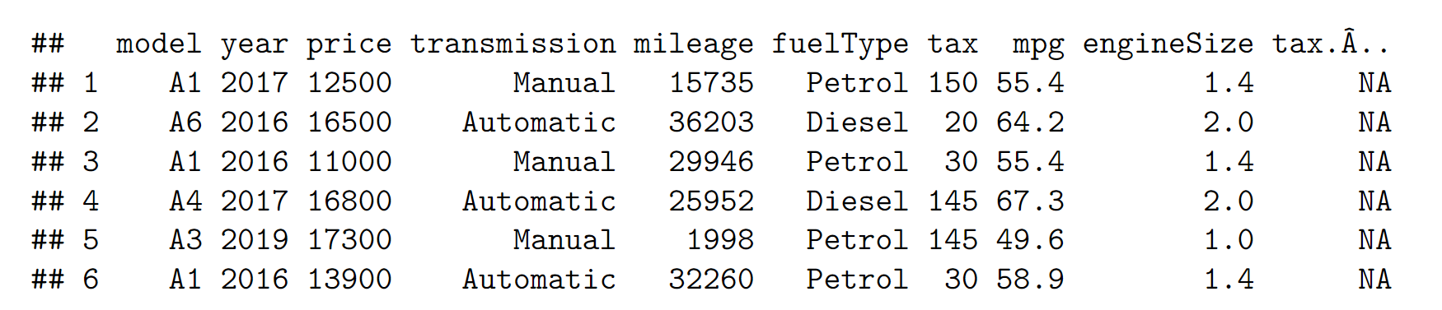
Data Description
A total of 396,748 observations of used cars sold that were built between 1970 and 2020
10 dimensions
Mode Year Built
Price Transmission
Mileage Fuel Type
Taxes Miles Per Gallon (MPG)
Engine Size Taxes (euros)

Slide 3


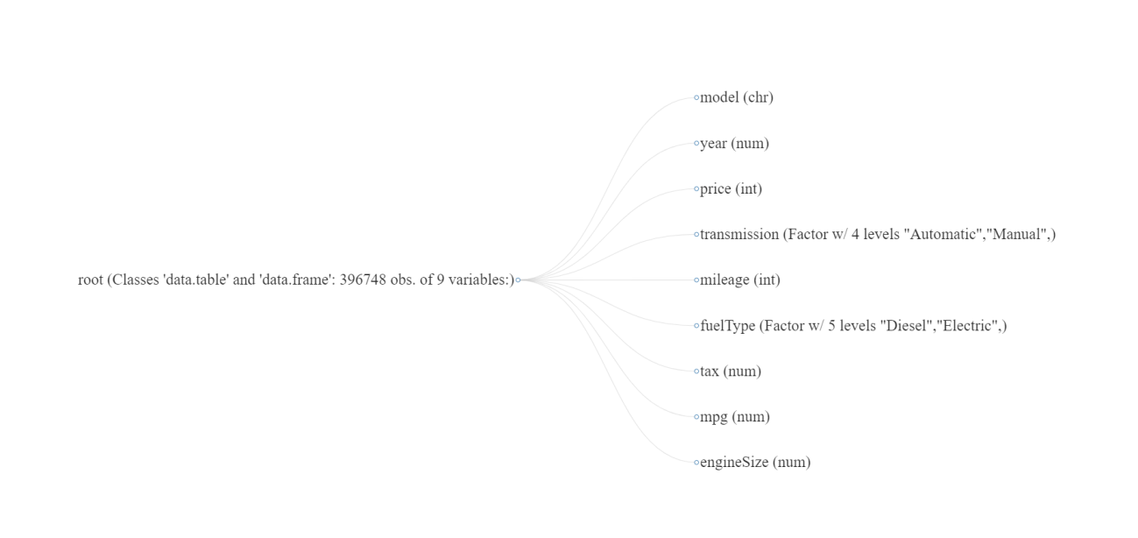

Transforming the Data
Notes:
we determined that the transmission size and fuel types were a characters. After further analysis, we decided to transform the transmission and fuel type were transformed to factor. So we designated target values such as 0 for manual transmission, 1 for automatic transmission and 2 for other transmission.

Slide 4
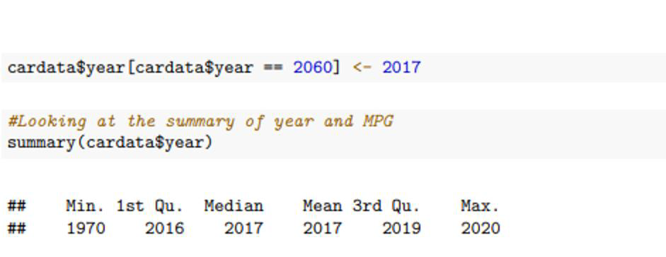
Outliers
z

Slide 5
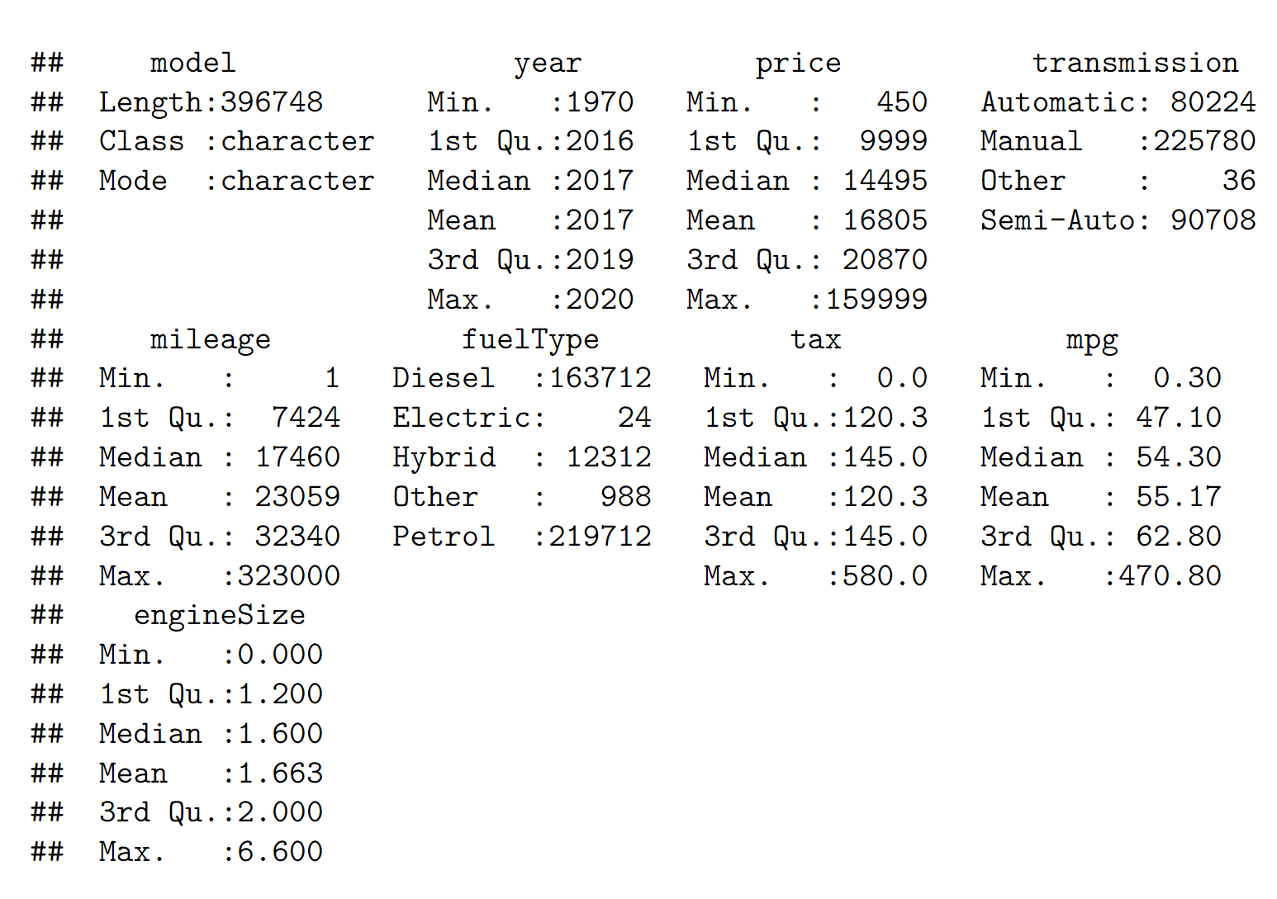
Mean, Median, and Mode

Slide 6
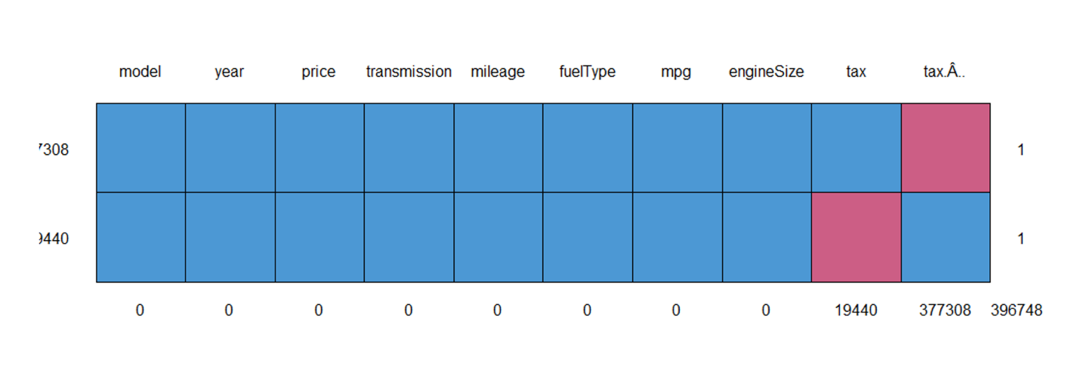
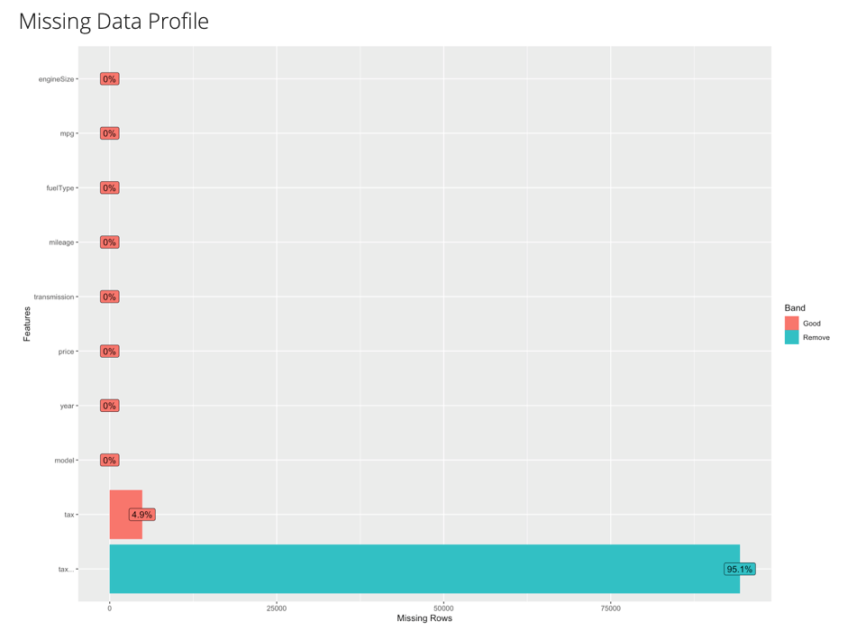
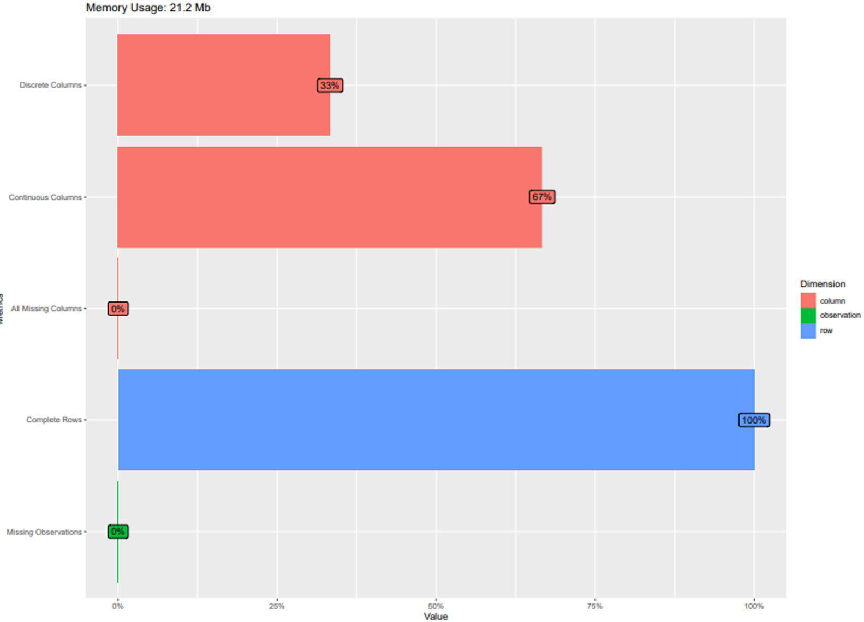
Missingness of the Data

Slide 7
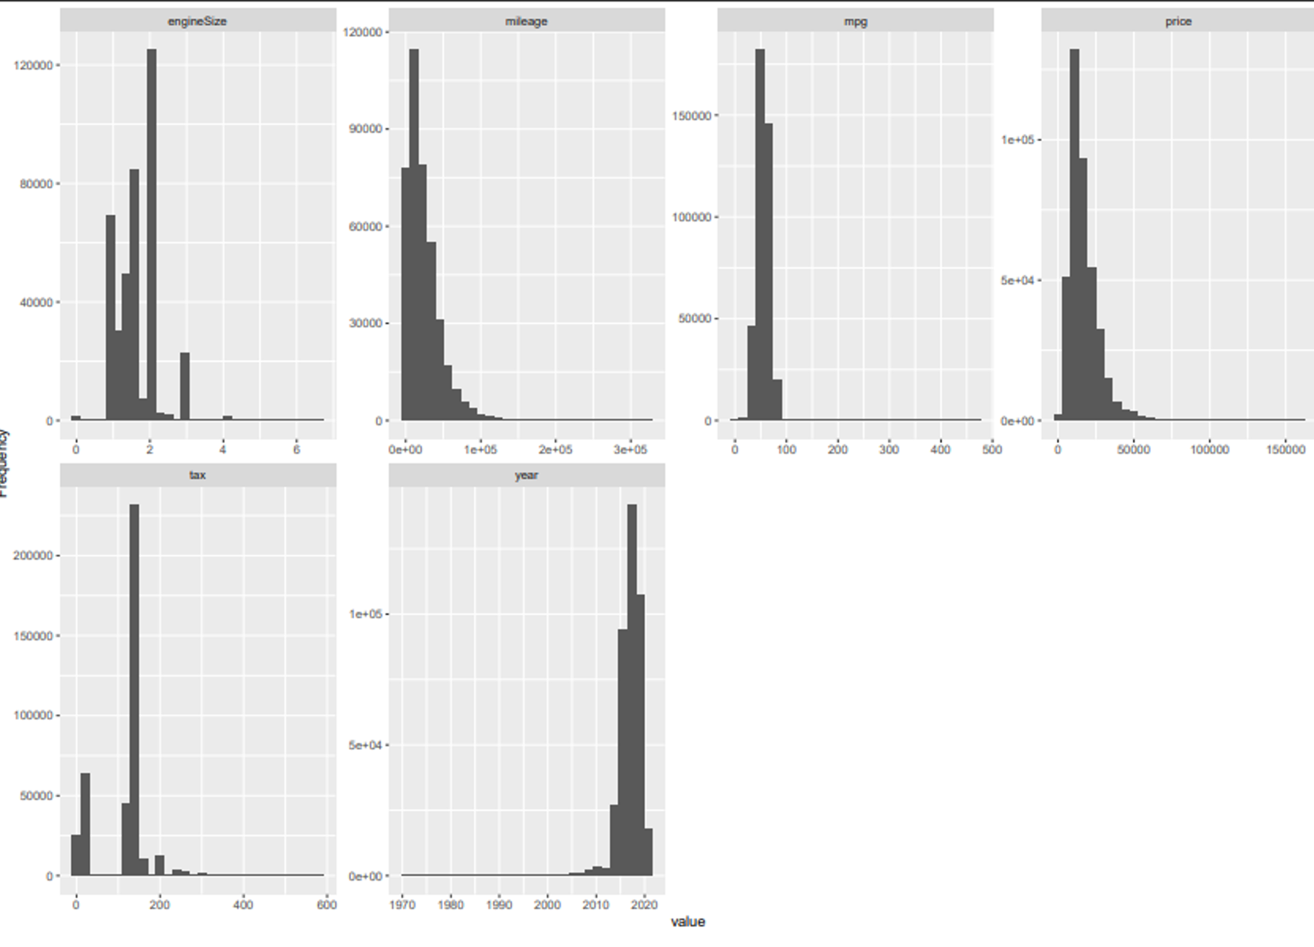
Measure of Skewness

Slide 8
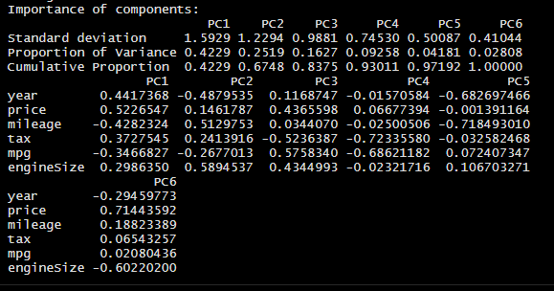
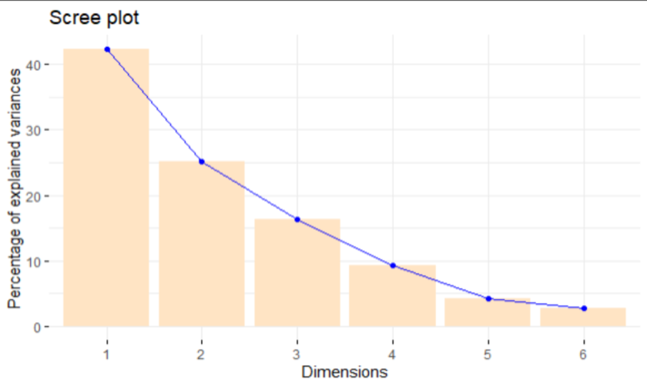
Principal Component Analysis

Slide 9
Prediction Models
LINEAR REGRESSION
DECISION TREE
RIDGE REGRESSION
LASSO REGRESSION

Slide 10
Linear Regression
Linear regression is one of the most used predictive modelling techniques .It is represented by an equation 𝑌 = 𝑎 + 𝑏𝑋 + 𝑒, where a is the intercept, b is the slope of the line and e is the error term. This equation can be used to predict the value of a target variable based on given predictor variable.

Slide 11
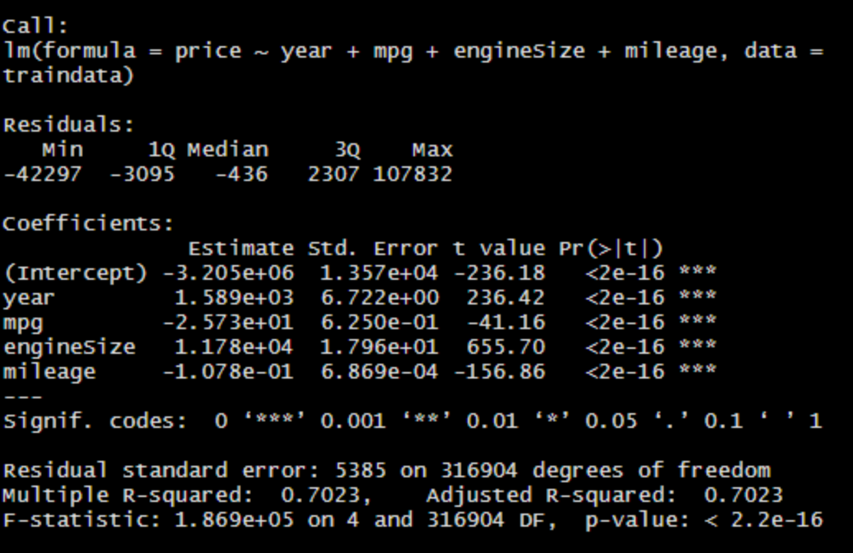
Linear Regression

Slide 12
Linear Regression
Y=-3.21 +1.59(year)-2.57(mpg)+1.17(Engine Size)-1.08(mileage)

Slide 13
Decision Tree
The goal of using a Decision Tree is to create a training model that can use to predict the class or value of the target variable by learning simple decision rules inferred from prior data(training data).

Slide 14
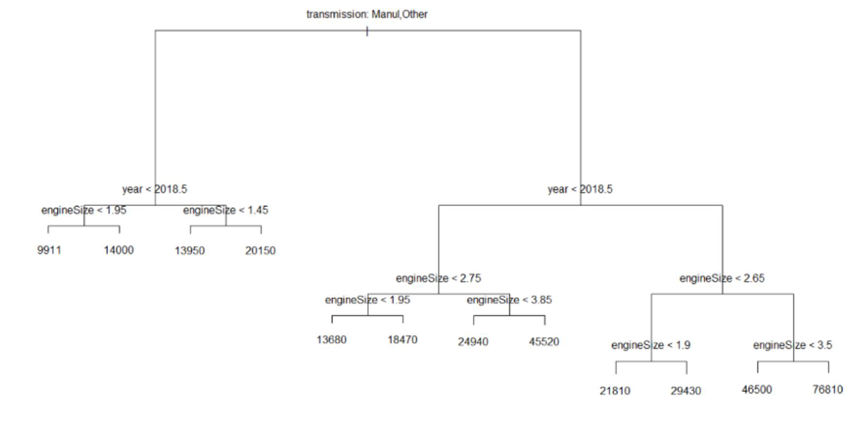
Decision Tree
The variables used in the model are Transmission, Year and Engine Size.
The rules of the decision tree are
1) Lowest Price Vehicle
When Transmission = manual AND Year < 2018.5 AND Engine Size < 1.95, then according to the prediction model the price of the car is $9,911.
2) Moderately Priced vehicle
When Transmission = Other AND Year > 2018.5 AND Engine Size < 2.65 AND Engine Size > 1.9 , then according to the prediction model the price of the car is $29,430.
3) Most Expensive Vehicle
When Transmission = Other AND Year > 2018.5 AND Engine Size > 3.5, then according to the prediction model the price of the car is $76,810.

Slide 15
Ridge Regression
Ridge regression is a model tuning method that is used to analyse any data that suffers from multicollinearity. This method performs L2 regularization. When the issue of multicollinearity occurs, least-squares are unbiased, and variances are large, this results in predicted values to be far away from the actual values.

Slide 16
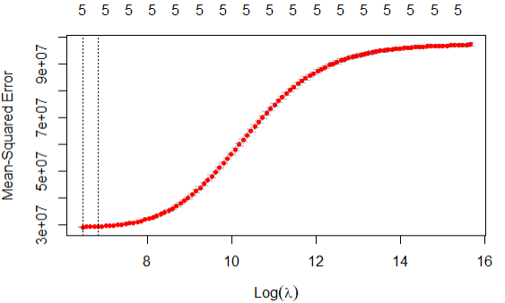
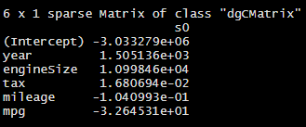
Ridge Regression
The variables that were utilized for this prediction model are year, engine size, tax, mileage, and mpg.
As λ increases, the flexibility of the ridge regression fit decreases, leading to decreased variance but increased bias.
λ= 629.8693

Slide 17
Ridge Regressioin
Y= 3.03+1.51(year)+1.10(enginesize)+1.68(tax)+-1.04(mileage)+-3.26(mpg)

Slide 18
Lasso Regression
Lasso regression is a type of linear regression that uses shrinkage. Shrinkage is where data values are shrunk towards a central point, like the mean. The lasso procedure encourages simple, sparse models (i.e. models with fewer parameters).

Slide 19
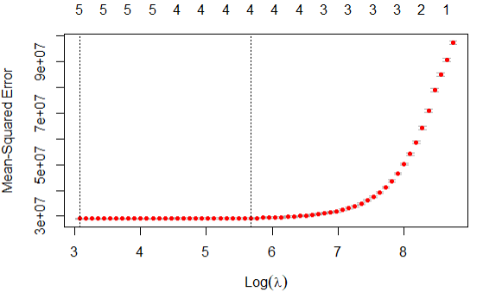
Lasso Regression
As λ decrease, the mean squared error decreases, leading to decreased variance but increased bias.
λ= 21.60747

Slide 20
Conclusion
Out of the 4 predictions models ran, we felt that linear regression was the best model of prediction
Linear Regression had an adjusted R-Square of 70.23 %
Accuracy was low at 54%
The Decision Tree Model was the next best model with an accuracy of 53%

